Slide 1
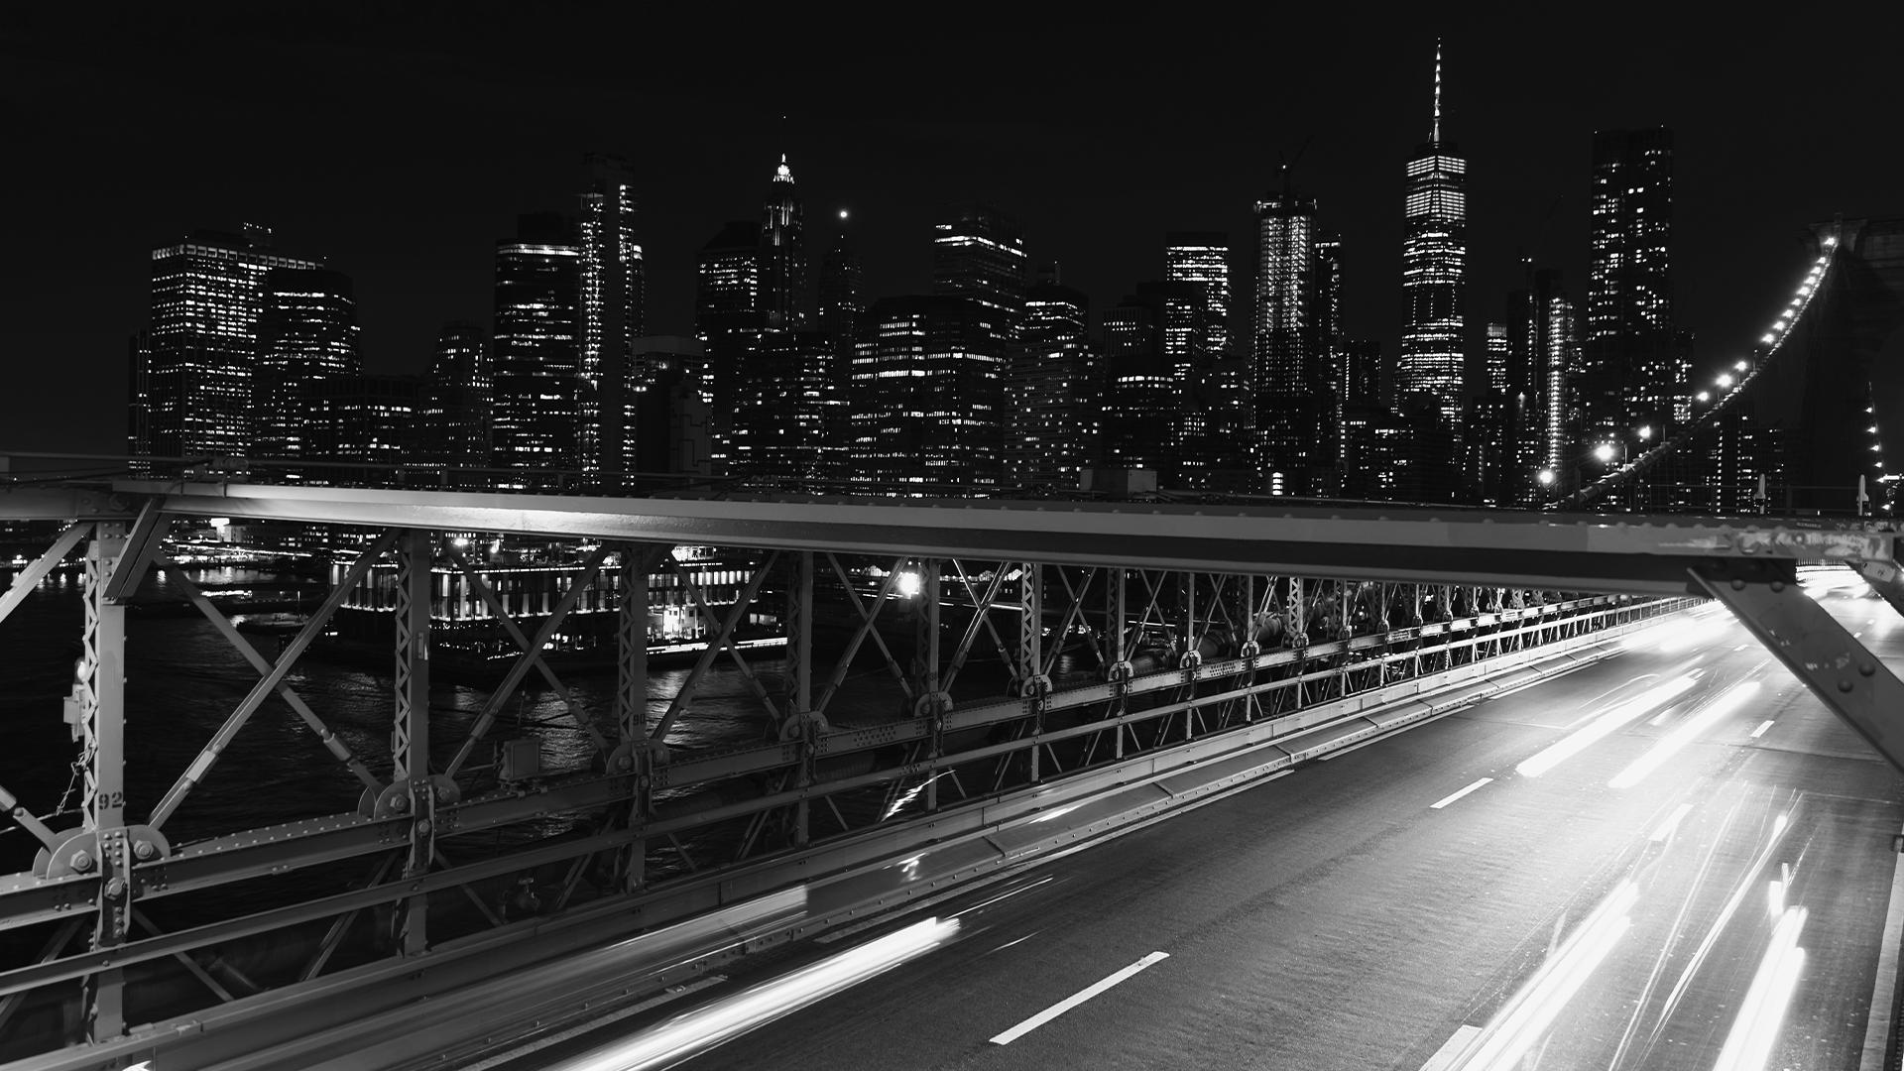
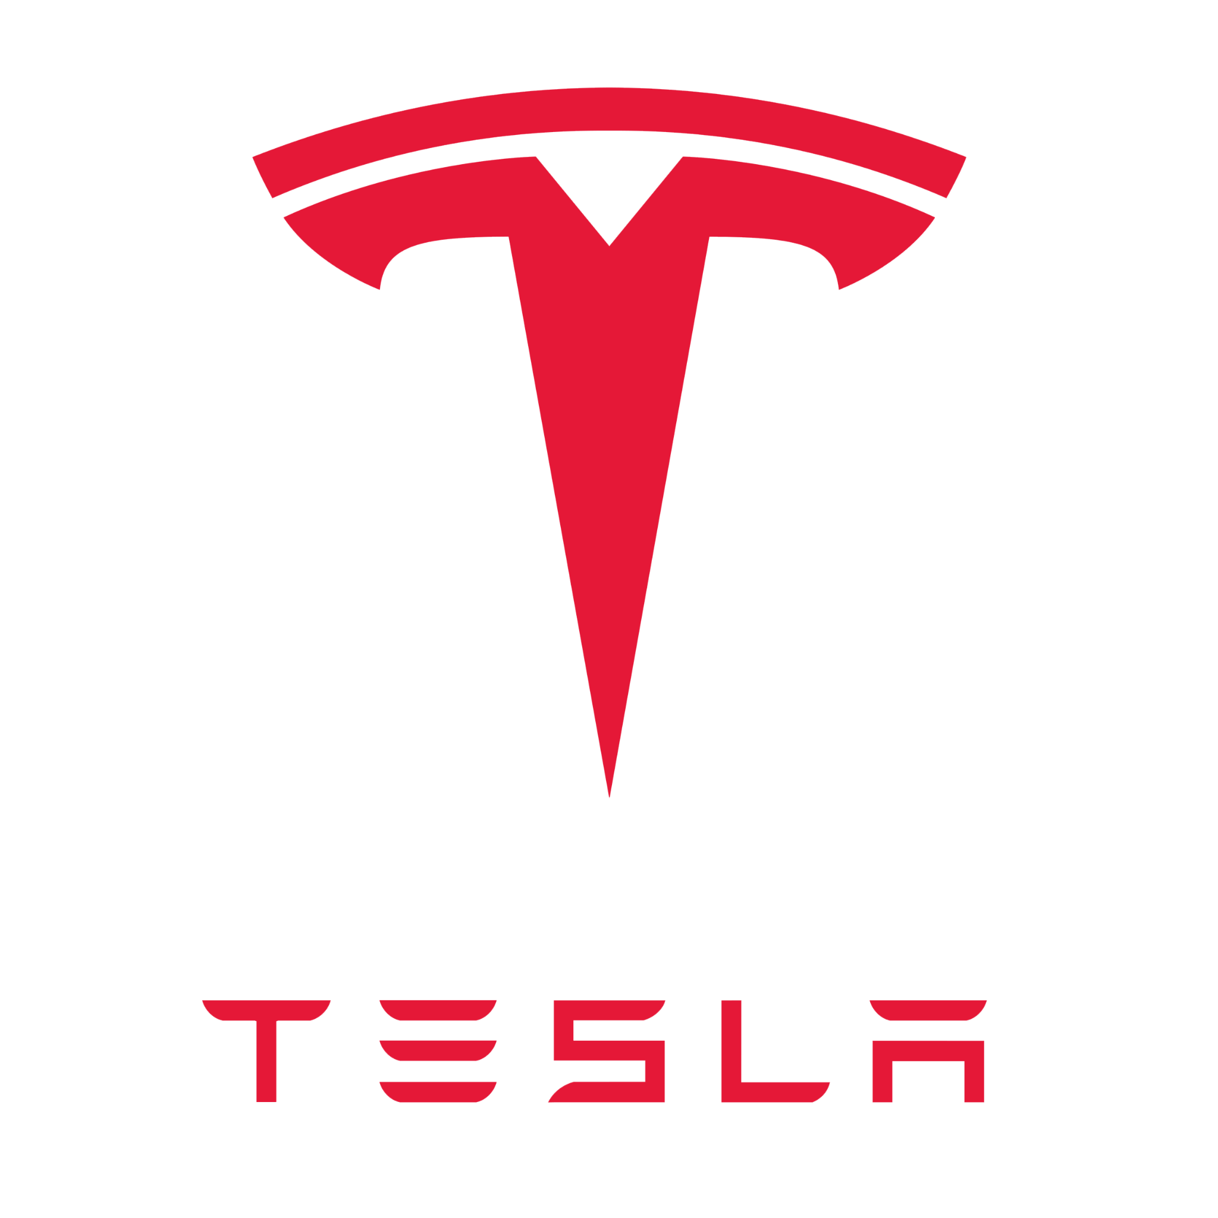
SWOT ANALYSIS OF TESLA
Sonu Kumar Kushwaha 2K19/CO/374

Slide 2
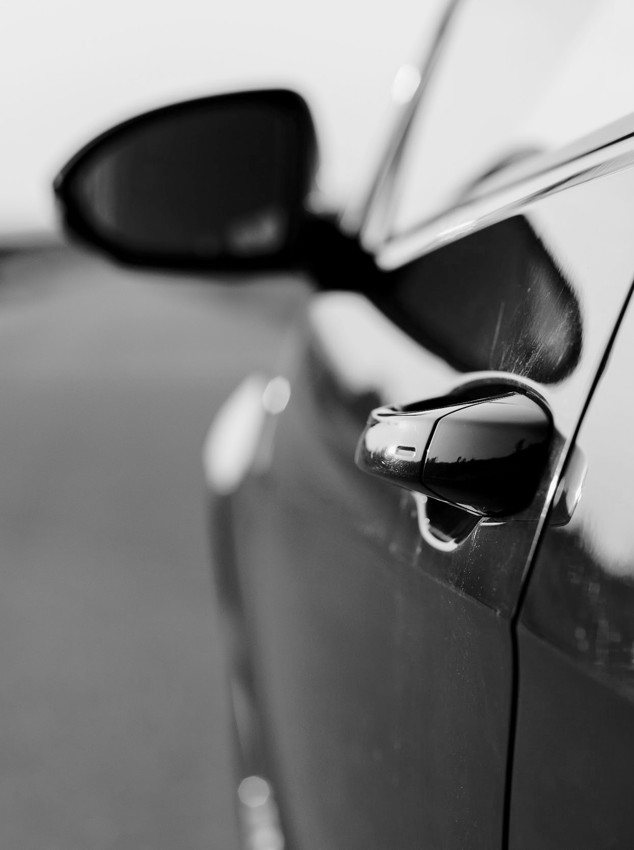
INTRODUCTION
Tesla was founded in 2003 by a group of engineers who wanted to prove that electric vehicles can be better, quicker, and more fun to drive than gasoline cars.

Slide 3
COMPANY OBJECTIVE
Tesla is a company that focuses on breakthrough technology and renewable energy, led by the vision of its CEO Elon Musk. Their goal is to lower carbon emissions and make the world a safer and more sustainable place for everyone.

Slide 4
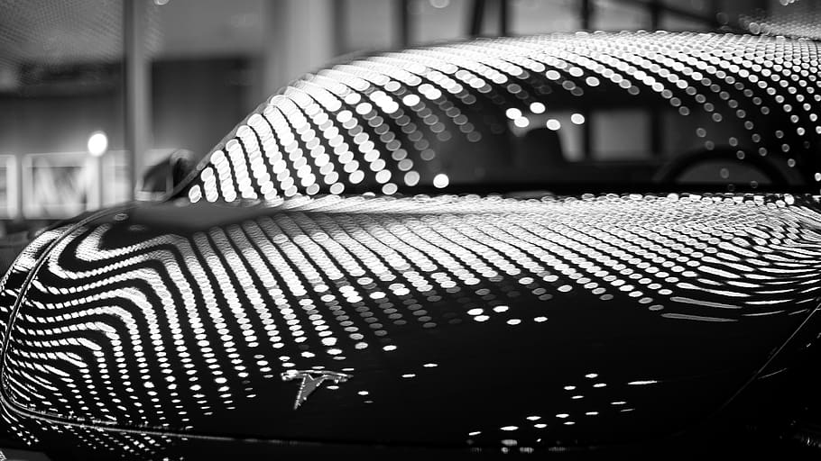
SWOT ANALYSIS

Slide 5
SWOT ANALYSIS
WEAKNESSES
THREATS
STRENGTHS
OPPORTUNITIES
Complexity of manufacturing
Low Production Volume
Limited Presence
Small Target Group
High Competition
Product Liability Allegations
Self Driving Regulation
Lithium-ion batteries pose a high risk
Innovation
Brand Equity
The Top Employer
The Most Valuable Automobile Firm
Robust Sales Growth
Best in-class Electric Cars
Less Expensive Car
Sales Expansion Globally
The Future of Sustainability
Automated Driving Technology

Slide 6
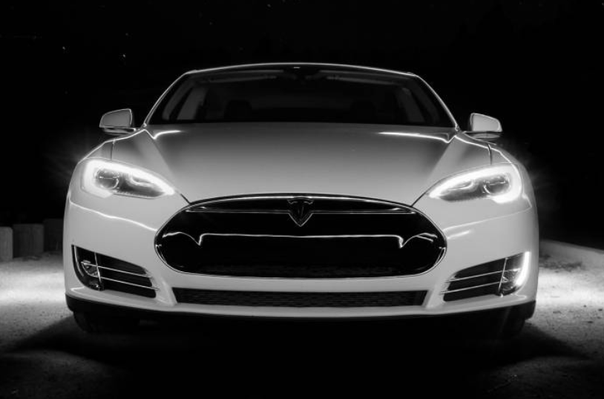
01
STRENGTH

Slide 7
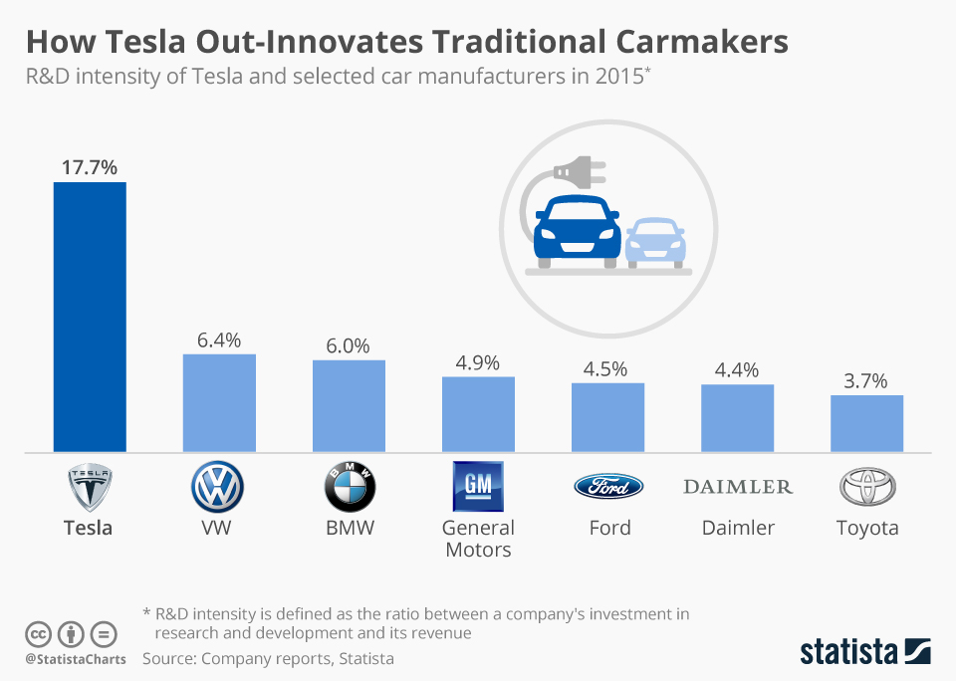
INNOVATION
Due to its continuous investment in R&D, Tesla is one of the most innovative companies on the market. As a result, the company is popular among those who are excited about the future of electric car technology. The popularity and financial benefits of a corporation rise as a result of a development.

Slide 8
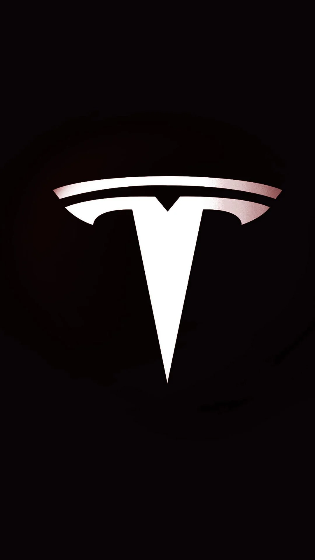
BRAND EQUITY
TOP EMPLOYER
MOST VALUABLE AUTOMOBILE FIRM
Tesla focuses on enhancing the user experience and product quality since it aspires to provide a fantastic driving experience in addition to producing automobiles. Tesla quickly became the first name that came to mind when people talked about electric cars all across the world, boosting brand equity.
Any business is only as good as the individuals that work for it. In the case of Tesla Inc., it is one of the most essential factors in the company success. Tesla has established itself as a great place to work because of its diversity and innovation-friendly culture.
In recent year 2021, Tesla's sales revenue was $53.8 billion, with 936,172 cars sold to consumers. The company's market value hit $1 trillion, surpassing the total market capitalization of the top five automakers (Toyota, Volkswagen, Daimler, Ford, and General Motor).

Slide 9
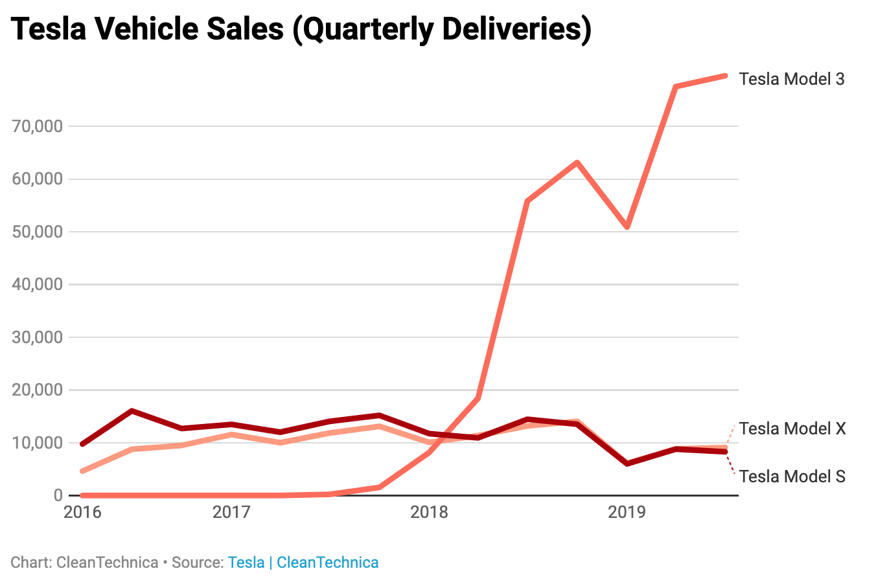
ROBUST SALES GROWTH
Tesla has experienced significant growth in recent years, thanks in large part to the public's enthusiasm for its cars. Sales climbed by 27% in 2015, following a 59 percent gain the year before. Last year, the corporation supplied a total of 936,000 automobiles, a rise of 87 percent above 2020 figures. The company said in February that it expects 50% annual growth in sales, meaning it expects about 1.4 million vehicles to be delivered this year.

Slide 10
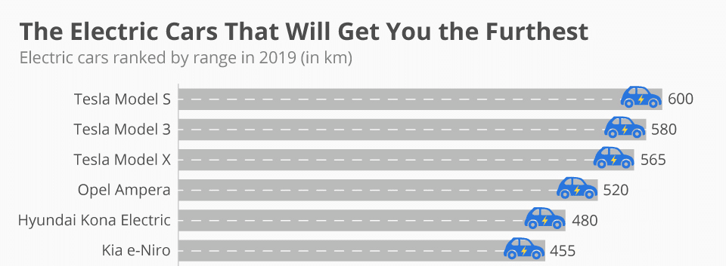
BEST IN CLASS ELECTRIC CARS
Tesla's electric cars have shown to be capable of travelling long distances. Tesla Model S will take you the farthest, with a single battery charge lasting up to 600 kilometres. Opel Ampera, which has a range of 520 kilometres, is the closest competitor.

Slide 11
02
WEAKNESS

Slide 12
MANUFACTURING COMPLEXITY
LOW PRODUCTION:
LIMITED PRESENCE:
Tesla has been able to compete with the world's major vehicle companies in a short period of time. The greater the degree of innovation, the greater the mechanical difficulties and production risk. Tesla has had a history of launch, manufacturing, and ramp-up delays. It continues to be one of its most pressing issues, since it is unable to reach high manufacturing volumes.
Tesla is without a doubt the pioneer of true energy-saving automobiles. However, none of its models have been able to sell in large numbers. Even now, as the business prepares to mass-produce Model 3 vehicles,there are challenges in terms of manufacturing costs and managerial resources.
Although Tesla yearly sales are fast increasing, the United States remains the company's largest market. Outside of the United States and China, Tesla's sales channels are inadequate, hampered by competitors' global distribution networks.

Slide 13
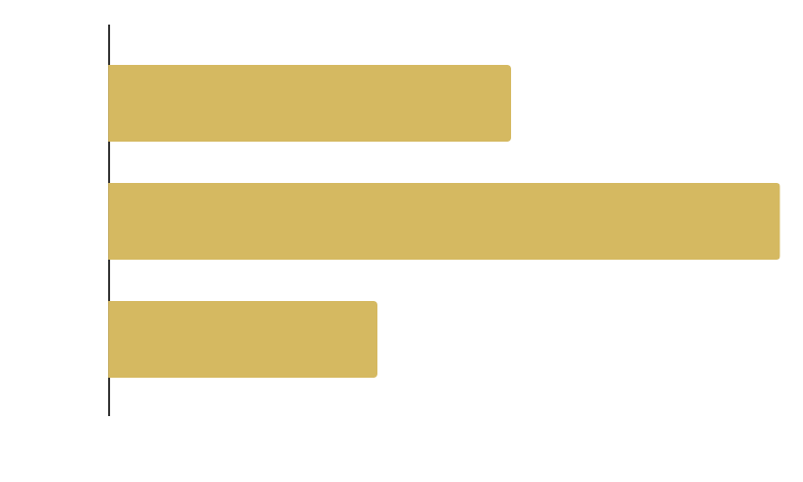
TARGET AUDIENCE
AGE & GENDER
Tesla's goal was to provide premium products to a small market while maintaining a premium automobile corporate image. Because of the high product prices, the market is small, making expansion difficult. Despite its reduced price, Tesla's Model 3 appeals to a wider audience, yet it still only reaches a small number of individuals.

Slide 14
03
OPPORTUNITIES

Slide 15
01
LESS EXPENSIVE CARS
02
SALES EXPANSION GLOBALLY
Tesla recently released the Model 3, an inexpensive version of the Model S with less range, power, and features, a fantastic opportunity for Tesla to grow their audience market.
Right now, the company's most important potential is the Asian market, which is still underserved in the automotive and renewable energy sectors. Especially in light of Tesla's desire to grow its worldwide market in order to improve its financial stability and market presence.

Slide 16
03
FUTURE OF SUSTAINABILITY
04
AUTOMATED DRIVING TECHNOLOGY
During the shift from fossil fuels to sustainable energy, demand for sustainable products skyrocketed. Tesla is one of the few firms that is developing renewable energy and electric car goods. As a result, demand for its goods and possibilities is increasing every day, and the company's market share is increasing as well.
Tesla's autopilot technology is regarded as one of the most successful systems in terms of showing safety and convenience across the world. This type of technology is substantial enough in the automobile business to be considered a reform. The electric car developed by the tesla has a lot of potential for the future of autos.

Slide 17
04
THREATS

Slide 18
COMPETITORS
TOYOTA, HYUNDAI,
KIA, MAHENDRA, FORD
TESLA
Traditional Gas Powered Vehicles
Same Old Design
Inferior Interior
Manual Driving
Electric Powered Vehicles
Modern Design
Superior Interiors
Autopilot Driving
Tesla, Inc. is facing stiff competition from alternative fuel vehicles (hybrid, plug-in hybrid, and fully electric cars) as well as self-driving technology.

Slide 19
PRODUCT LIABILITY ALLEGATIONS
SELF DRIVING REGULATIONS
Tesla is concerned that product liability litigation will be one of the company's most serious financial setbacks. Tesla has delivered a number of self-driving vehicles, but not all of them have proven to be safe in an accident. Several lawsuits have been brought against the company.
Tesla has spent considerably in autopilot technology, but no nation, including the United States, has appropriate \ self-driving cars. Tesla's future is in danger by this inappropriate legal condition, as well as people's inability to buy a Tesla.

Slide 20
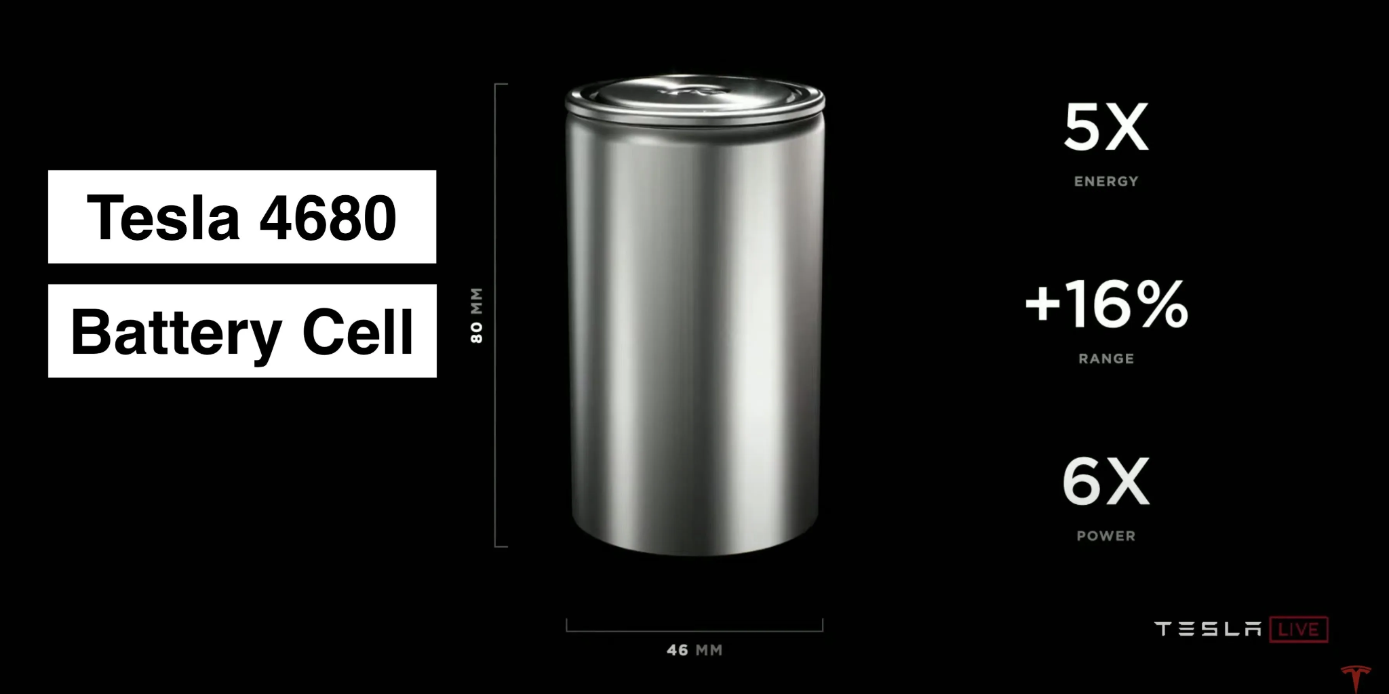
LITHIUM-ION BATTERY POSES HIGH RISK
Tesla's battery packs are made up of lithium-ion cells. Because lithium is a highly reactive and explosive element, their goods have a higher risk factor. Tesla has had a couple incidents where their cars have caught fire and emitted smoke, which has severely caused lose to the company.

Slide 21
CONCLUSION
Tesla is a revolutionary vehicle firm that is determined to change the face of driving in the future. They are not just focused on producing elegant, eco-friendly vehicles for the wealthy but also on making advances in autonomous driving.
This SWOT analysis highlighted each of Tesla’s market strengths, weaknesses, opportunities, and threats. Tesla must take decisive action to increase its market share and financial stability.
According to the SWOT analysis, Tesla must –
Continue and expand research into alternative energy sources.
Work on building consumer trust and long-term confidence in the organization.
Extend the reach internationally and try to secure global production.

Slide 22
REFERENCES
1. https://bstrategyhub.com/tesla-swot-analysis/
2. https://iide.co/case-studies/swot-analysis-of-tesla/
3. https://www.tesla.com/
4.https://seoaves.com/tesla-swot-analysis/
5. Lashley, B.C., 2017. Communicating Community at Tesla Motors: Maintaining Corporate Values in Blogging Communities (Doctoral dissertation, Virginia Tech).
6. Mintel. “Marketing to Generation X - U.S.” June. 2016. Mintel. UGA Library, Athens, GA. 22 Oct. 2019. “Tesla Model 3 Case Study.” Media Flight Plan, https://mediaﬂightplan.com/.
7. Alvarez, Simon. “Tesla Spends $0 on Ads, Still Tops Automakers in Organic Engagement: Report.” TESLARATI, 7 May 2019, www.teslarati.com/tesla-advertising-organic-social-media-engagement/.

